Slide 1
Online Tools We make it easy for plan sponsors and participants
Notes:
The Standard is currently upgrading many of its services for retirement plan participants.
Topping the upgrade list are our Personal Savings Center and PlanNet services.

Slide 2
Plan Participant And Sponsor Benefits
A simple, easy-to-use website available 24/7 for participants and sponsors alike.
For participants, simple and easy-to-use means:
“Summary view of account status that I can check regularly”
“Simple steps for me to make changes to my account”
“Tools to help me make retirement decisions”
For plan sponsors, simple and easy-to-use means:
“Access to the services I need to manage my plan”
“Insight into participant activity, so I can assist where necessary”
Notes:
<Read Slide>

Slide 3
Making It Easy For Plan Participants
Notes:
Let’s first take a look at the upgrades being made on our Personal Savings Center website for participants....

Slide 4
Key Features For Participants
Simpler Navigation
More Graphics
Easy Access To What’s Most Important (Key Data)
Online Access To Quarterly Statements
Notes:
The Standard’s Personal Savings Center website is designed to meet the needs of retirement plan participants.
While the site already contains a robust suite of services, surveys of our customers identified ways that it could be made better:
Moving key data to more prominent locations,
Using more graphics to get important messages across,
Making navigation more efficient and intuitive, and
Offering participants online access to their quarterly account statements.
We listened to that feedback as we planned changes to the site, and now we’re pleased to share how those ideas are becoming a reality.

Slide 5
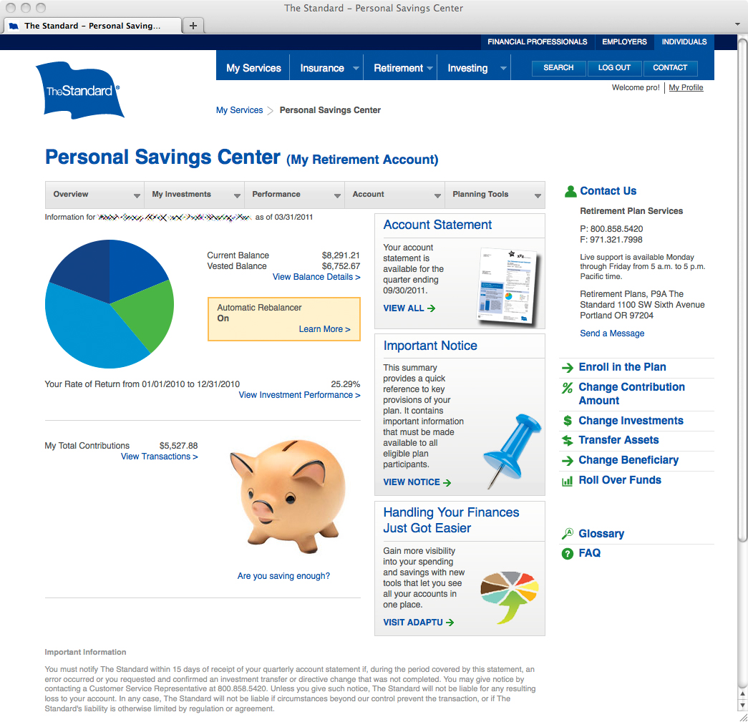
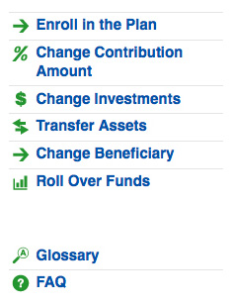
Simpler Navigation
Enroll in a Plan
Change Contribution
Change Beneficiary
Roll Over Funds
Notes:
Web page design has evolved in recent years, with new standards in navigation design.
We’re using those standards to make navigation in Personal Savings Center more efficient and intuitive.
The most frequently used destinations are highlighted in the new navigation bar, making it possible for participants to more quickly reach the data or transaction they seek.

Slide 6
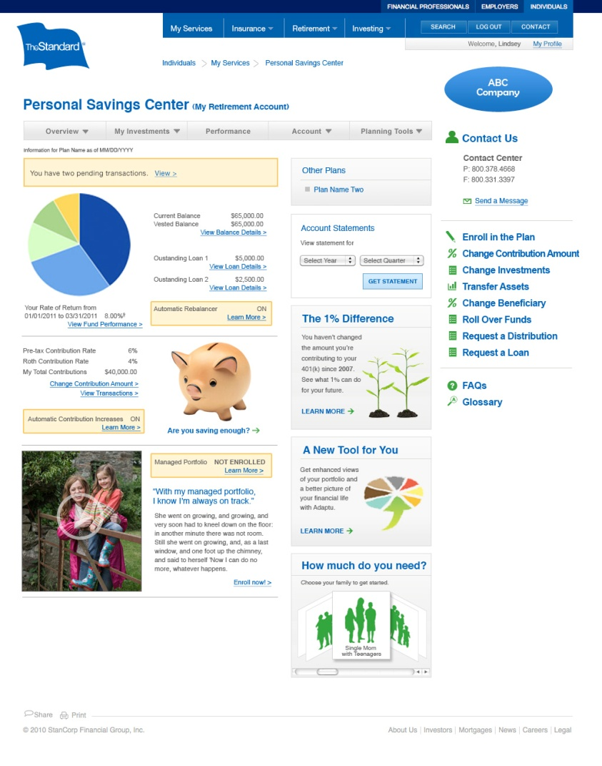
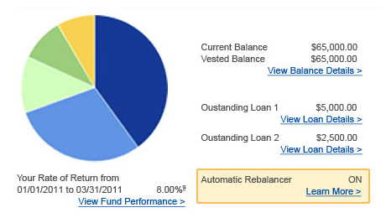
More Graphics
Information is:
Easier-to-understand
More compelling
Viewed quickly
Notes:
“A picture is worth a thousand words” is particularly true when the topic is investments or asset allocation. Use of pie charts make complicated concepts such as the importance of diversification, or the reality of being over-weighted in a single fund or asset class, evident at a glance.
You’ll also note that there are more graphics used throughout the redesigned site. People have become more dependent on visuals in recent years – we’re now more reliant on seeing messages as opposed to reading them. Our intent is to adapt to that change, delivering data and educational information in a way that is compelling to participants.
In addition to the use of graphics, participants will soon be able to view their account statements online.

Slide 7
Easy Access To What’s Most Important
Most Popular Participant Needs:
See My Balance
See the Return On My Investments
View My Loans
Outstanding loan balance
Overview of My Contributions
How much am I contributing?
Contributions since inception
Notes:
Our research revealed the most important information participants are looking to receive when they visit Personal Savings Center.
The redesign of the site places most of this information in a more prominent location than before. Additional details are generally one click away from this page.

Slide 8
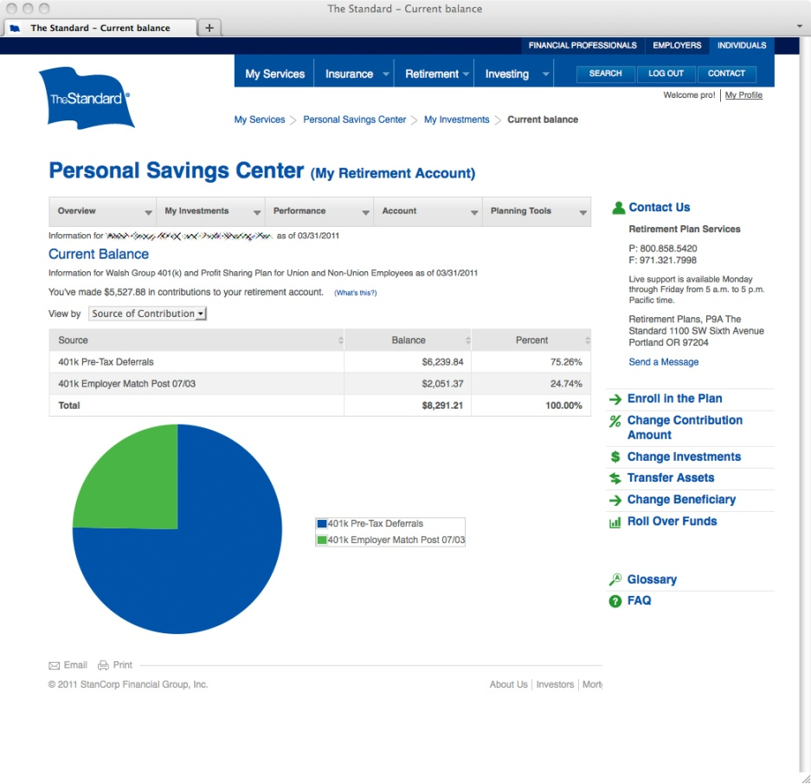
See My Balance By Source Of Contribution
Details By Source of
Contribution
Sortable Columns
Interactive Graphics
Notes:
Today, participants can view their balance information in a variety of ways, including source of contribution.
With the redesigned site, participants can choose how they want their balance information presented. First, the information displayed in the tables can be sorted by clicking any of the column headers. Participants can also move their mouse over areas of the interactive pie chart to quickly see how their source of contributions is divided.

Slide 9
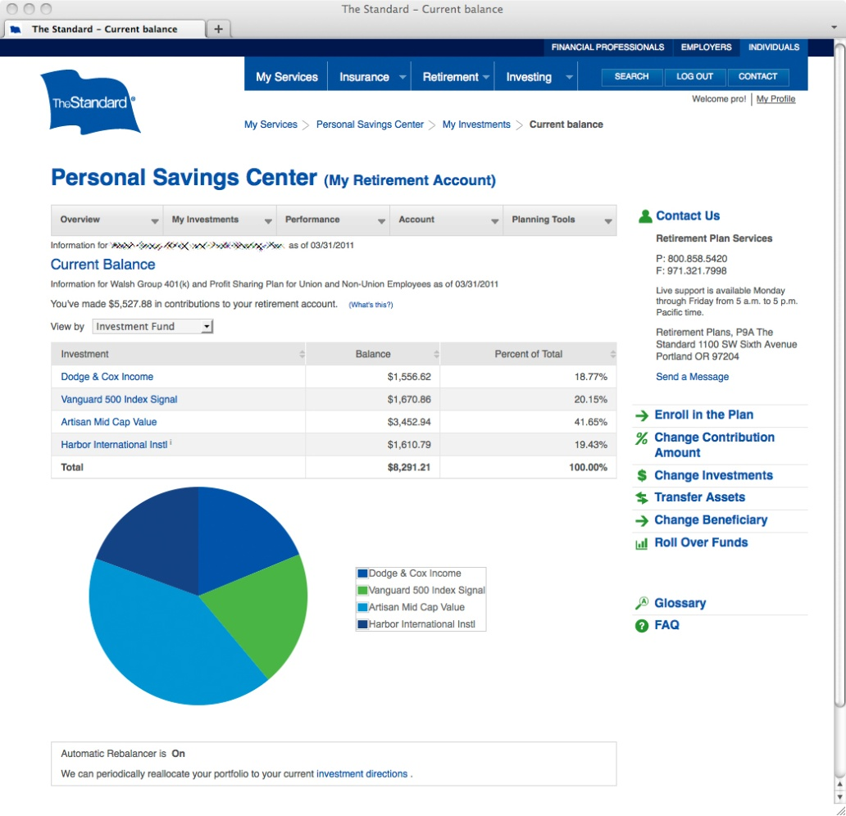
See My Balance By Investment Fund
Details By Investment
New Visual Presentation
Shows Total Allocation
Notes:
The redesigned site will contain a new chart that illustrates a participant’s balance information by investment.
Providing alternatives to how participants view their information can make a big difference.

Slide 10
See My Balance By Units Owned
Details By Units/Shares
Owned
Sortable Columns
Notes:
As was the case with viewing balances by source of contribution, participants can also sort the information in the columns as they view their units or shares owned.

Slide 11
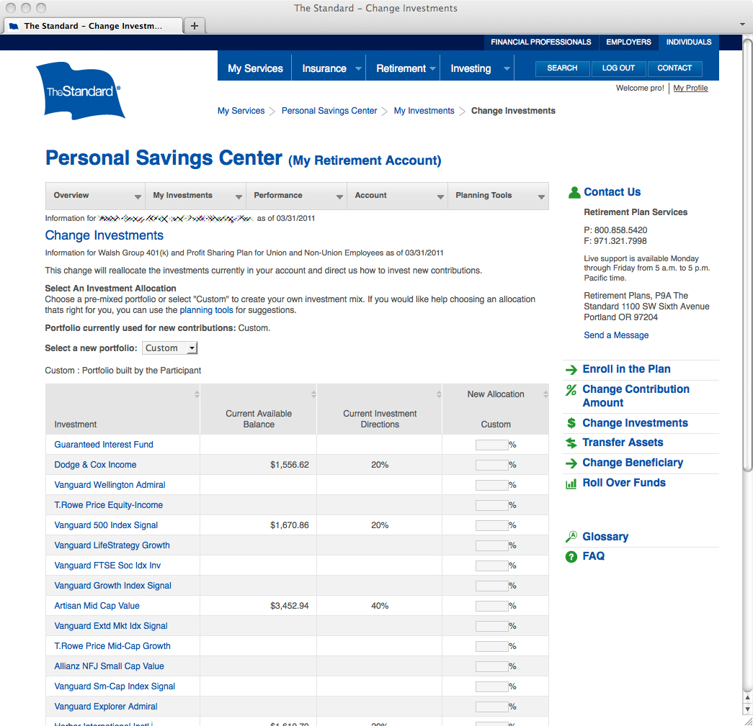
Simple Steps To Manage My Investments
Change Investment Mix
Current Balance Only
Future Contributions Only
Or Both
Portfolio Descriptions (Where Applicable)
Notes:
Transaction pages are getting a similar makeover intended to make them more intuitive and easier to use.
In many cases, we’ve been able to reduce the number of steps required to complete a transaction. In others, we’ve simplified the transaction.
In the redesigned site, participants will be able to change the investment mix of their future contributions and their current balance — not just one or the other. In addition, participants of plans with pre-mixed portfolios will have access to helpful descriptions of the portfolio.

Slide 12
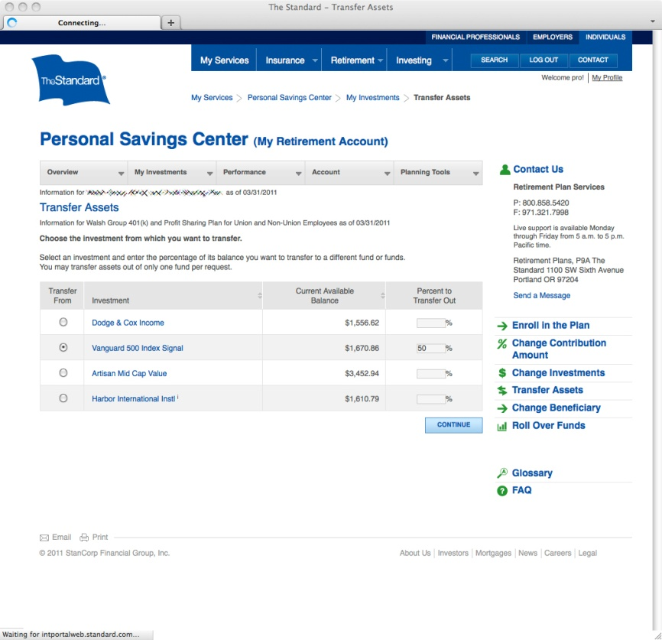
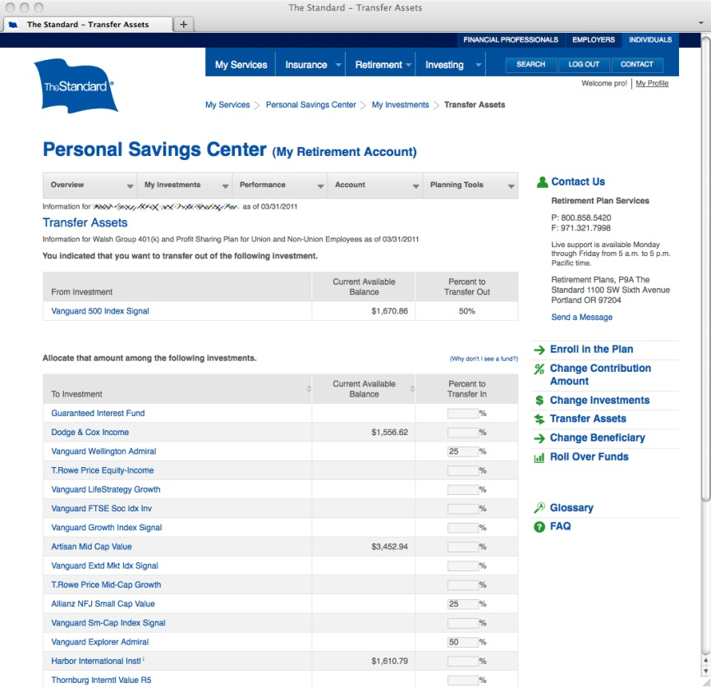
Simple Steps To Manage My Investments
Transfer One Fund To Another
Easy, Step-by-Step Process
Notes:
Thanks to the visual enhancements we’ve made to the site overall, our step-by-step process of helping a participant initiate a transfer is not
only easier on the eyes, but as a result, easier to understand.

Slide 13
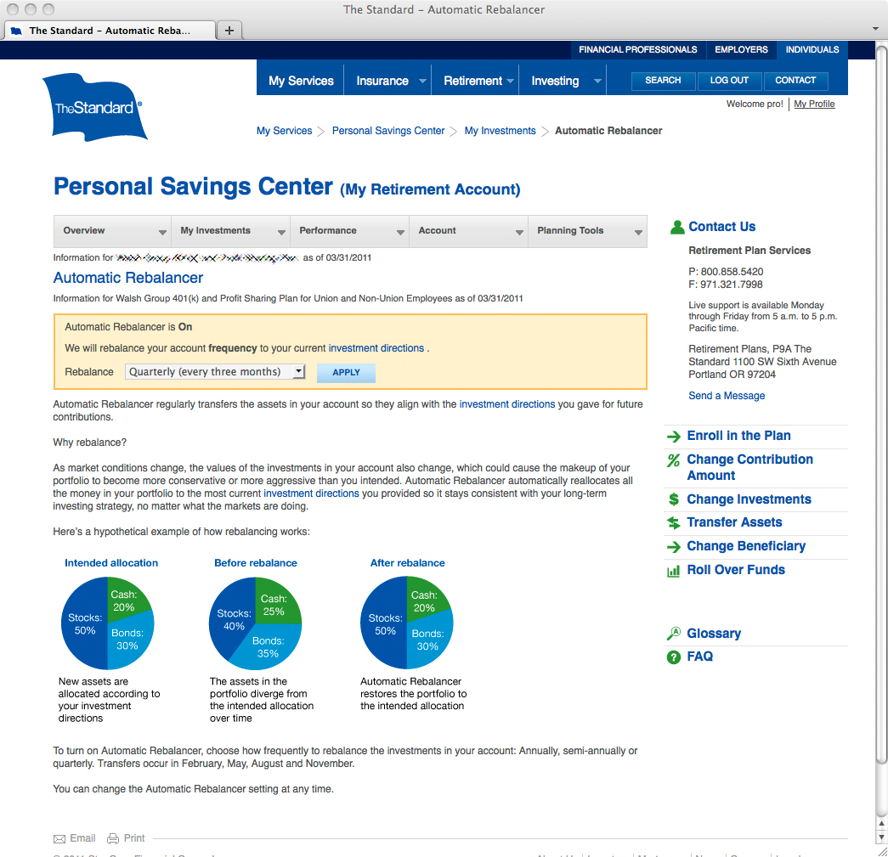
Simple Steps To Manage My Investments
Turn Automatic Rebalancer On/Off
New Graphics To Illustrate Benefits
Notes:
Currently, participants have the option of turning Automatic Rebalancer on or off, at their convenience. The Automatic Rebalancer feature will
periodically transfer assets in your participants' accounts to keep them aligned with their investment directives.
For participants who may be unaware of the benefits of Automatic Rebalancer, the redesigned site will contain new graphics that clearly illustrate its value.

Slide 14
The Standard is the marketing name for StanCorp Financial Group, Inc. and its subsidiaries. StanCorp Equities, Inc., member FINRA, distributes group annuity contracts issued by Standard Insurance Company and may provide other brokerage services. Third-party administrative services are provided by Standard Retirement Services, Inc. Investment advisory services are provided by StanCorp Investment Advisers, Inc., a registered investment advisor. StanCorp Equities, Inc., Standard Insurance Company, Standard Retirement Services, Inc., and StanCorp Investment Advisers, Inc. are subsidiaries of StanCorp Financial Group, Inc. and all are Oregon corporations.
RP 15996 (12/11)

